Slide 1
Task 3 – Sales Dashboard Design
Power BI Project for Data Analyst Internship
GIRIJA R 07 August 2025

Slide 2
Dataset Description
Dataset Name: Product_Sales.csv
Source: Kaggle
Fields Used:
Agent Name
Product Sold
Call Duration
Picked Up Calls
Customer ID

Slide 3
KPIs and Dashboard Elements
KPIs (Cards):
Total Products Sold
(Optional: Total PickedUp, Total Duration)
Visuals Used:
Donut Chart – PickedUp by Agent
Bar Chart – ProductSold by Agent
Slicers – Agent Name, Customer ID

Slide 4
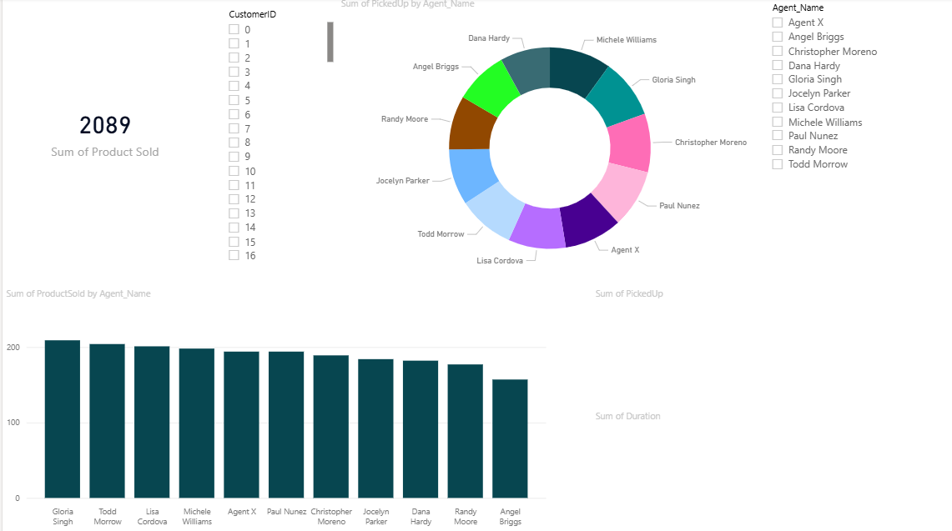
Interactive Dashboard View

Slide 5
Key Insights:
A total of 2089 products were sold across all agents.
The top-performing agent in product sales is Gloria Singh, followed closely by Todd Morrow and Lisa Cordova.
Most agents have a similar performance in terms of products sold, showing consistency across the team.
The donut chart indicates that PickedUp calls are well distributed, with no major drop-offs among agents.
The dashboard includes Customer ID and Agent Name slicers, allowing stakeholders to filter the data dynamically.

Slide 6
THANK YOU!

